Slide 1

Differential Evolution with Adaptive Mutation and Crossover Strategy
for solving Nonlinear Regression problems
Ivanof Elena-Tamara
2nd year bachelor student in Artificial intelligence
Faculty of Mathematics and Informatics, UBB Cluj-Napoca

Slide 2
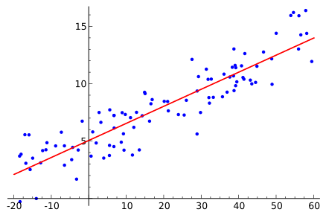
What are regression problems?
Regression
Fitting a mathematical equation to a set of observed data
Minimizing the error between the predicted values (according to the function) and the actual observed values

Slide 3

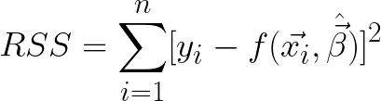
Solving a regression problem
General equation:
Method of least squares:
Finding optimal parameters = Minimizing RSS

Slide 4


Linear vs Nonlinear regression
Linear regression
linear relationship between independent and dependent variables
Analytic solutions
Example: relationship between house size (x) and price (y)
Nonlinear regression
nonlinear relationships between independent and dependent variables
Iterative optimization
Example: temperature forecasting

Slide 5
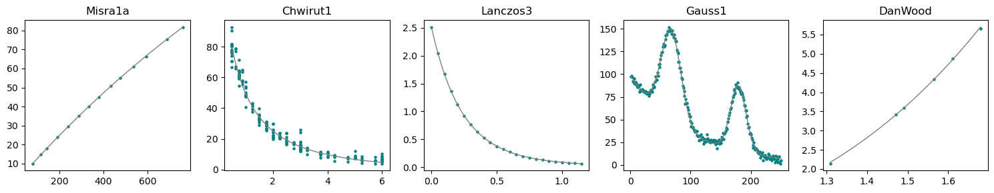
NIST models for nonlinear regression
The National Institute of Standards and Technology (NIST) proposed 27 datasets used for validating the accuracy and robustness of a certain minimization algorithm for nonlinear regression.
It includes both generated and "real-world" nonlinear least squares problems of varying levels of difficulty.

Slide 6

What is Differential Evolution?
Differential Evolution (DE) is a population-based stochastic optimization algorithm introduced by Storn and Price in 1997.
Designed for continuous optimization problems, DE is particularly effective for nonlinear, non-differentiable, and multimodal objective functions.
DE belongs to the family of Genetic Algorithms, and has three main operations: mutation, crossover, and selection.

Slide 7
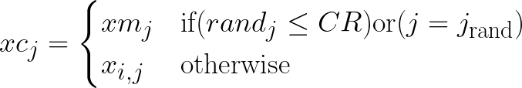

Differential Evolution – steps
Start with a random population of vectors
Mutate vectors
Apply crossover
Update vectors with better values (if found)

Slide 8
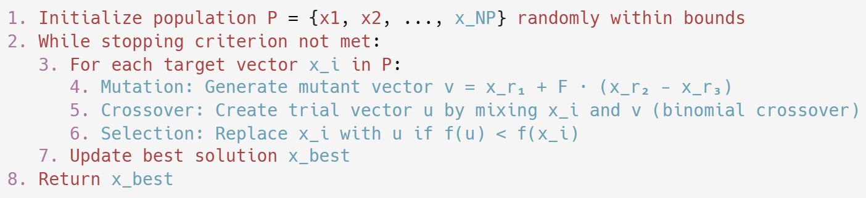
Differential Evolution – pseudocode

Slide 9
Differential Evolution - benefits and costs
The DE algorithm is a powerful tool for functional optimization.
It can handle:
High-dimensional problems
Multimodal optimization
Constrained optimization
Noisy & dynamic optimization
DE also has some disadvantages:
Not ideal for purely combinatorial problems unless hybridized
Slower convergence than gradient-based methods for smooth, convex problems

Slide 10
Why improve differential evolution?
The classical DE algorithm has a few limitations:
Fixed mutation and crossover strategies
Poor exploration vs. exploitation trade-off
Static values for scaling factor (F) and crossover rate (CR)
Requires manual tuning for each problem.
Premature Convergence
May stagnate in local optima for complex, multimodal functions.

Slide 11
Differential Evolution with Adaptive Mutation and Crossover strategies
Proposed by Watchara Wongsa, Pikul Puphasuk and Jeerayut Wetweerapong from Khon Kaen University, Thailand, in the article:
Differential evolution with adaptive mutation and crossover
strategies for nonlinear regression problems
Date published: Mar 6, 2024

Slide 12
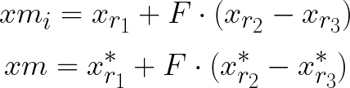
The DEAMC algorithm improves classical DE in the following ways:
Adaptive Mutation:
Dynamically switches between Classic Mutation (CM) and Sorting Mutation (SM) based on success rates.
Dynamic Crossover:
Alternates between low (CR ∈ [0, 0.1]) and high (CR ∈ [0.9, 1]) ranges.
Self-Tuning Probabilities:
Automatically adjusts strategy probabilities (pm1, pc1) using success histories.

Slide 13
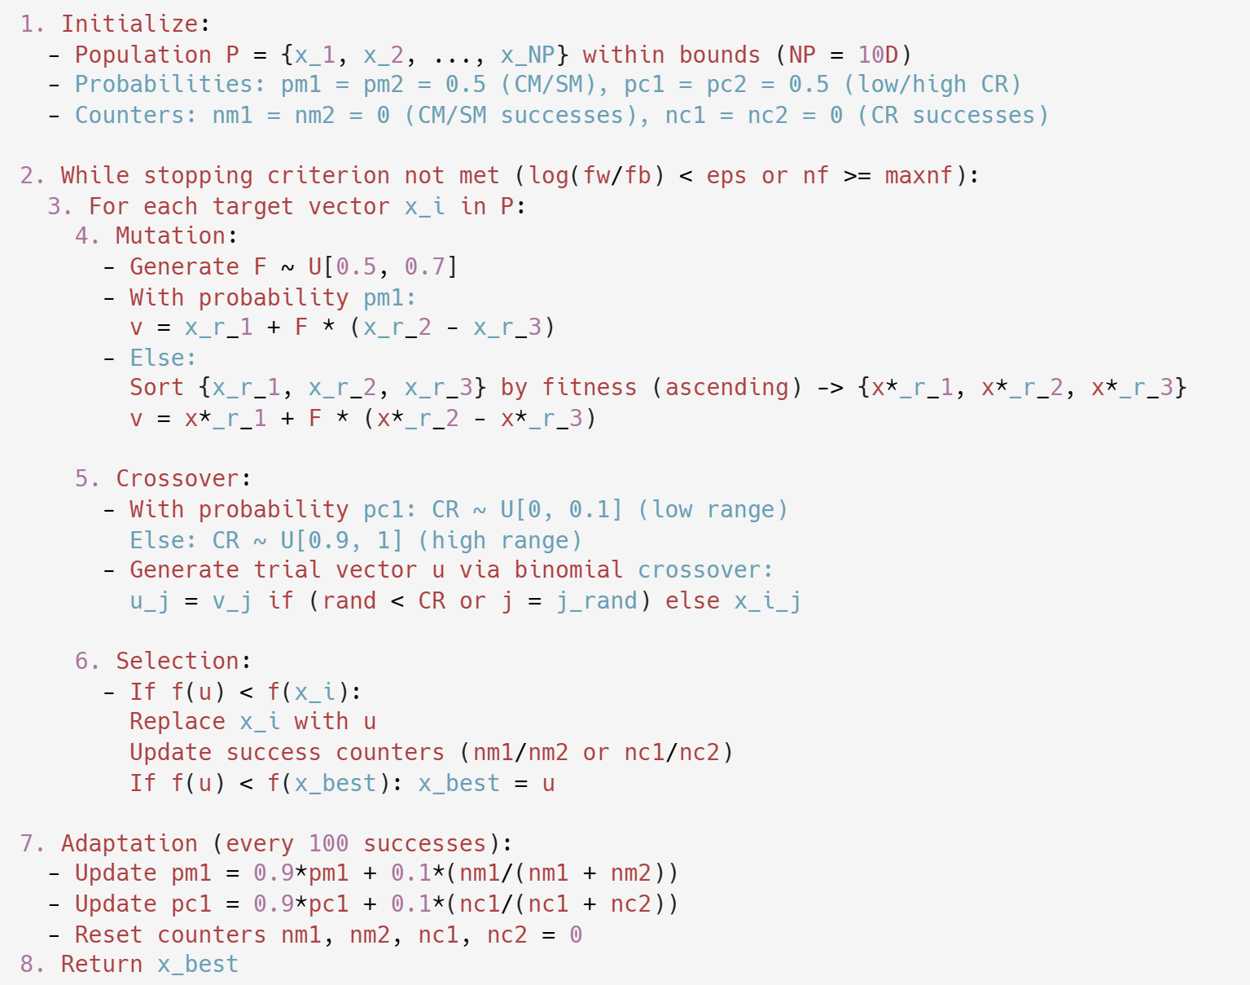
Differential Evolution with Adaptive Mutation and Crossover – pseudocode

Slide 14
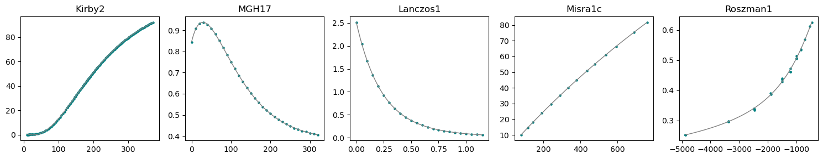
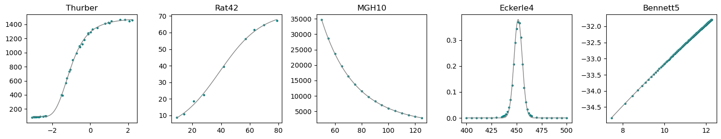
Applying DEAMC to nonlinear regression problems

Slide 15
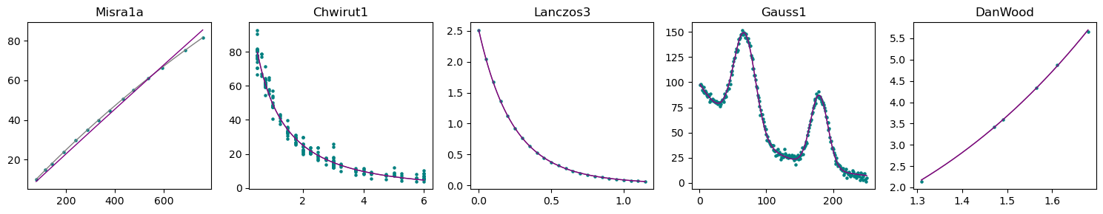
Preliminary results - Lower difficulty models

Slide 16
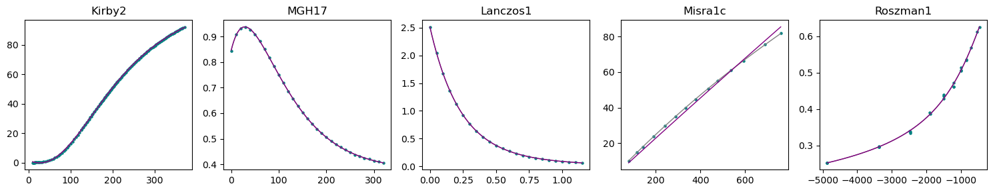
Preliminary results - Average difficulty models

Slide 17
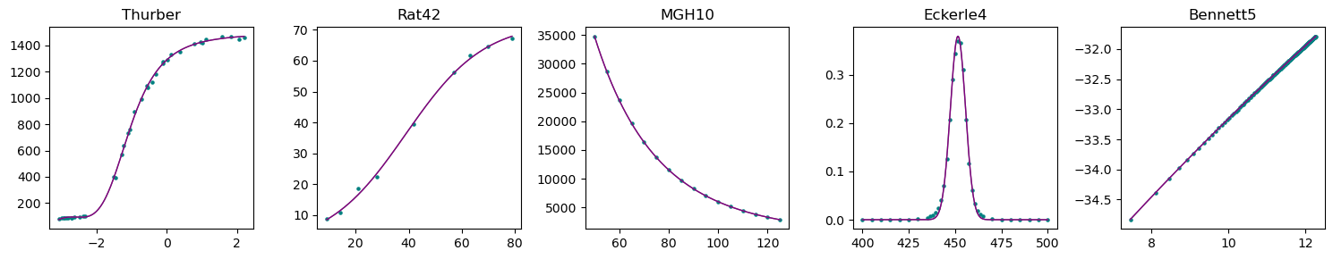
Preliminary results - Higher difficulty models

Slide 18
Performance analysis
fb - best value obtained from an algorithm
c - be the certified value for a problem
λ - number of decimal places that fb matches the certified value
NS - number of successful runs, calculated as the number of runs where the algorithm reaches early convergence and λ > 4
nf - number of evaluations before the algorithm stops

Slide 19
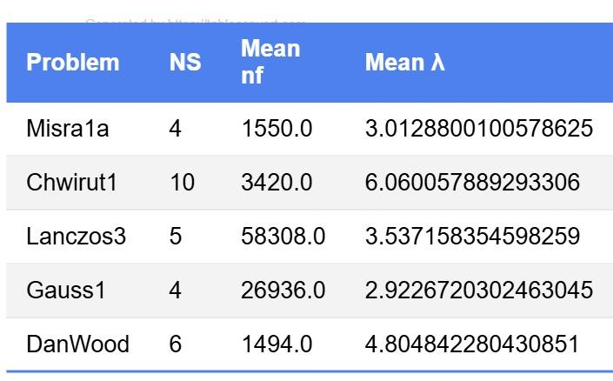
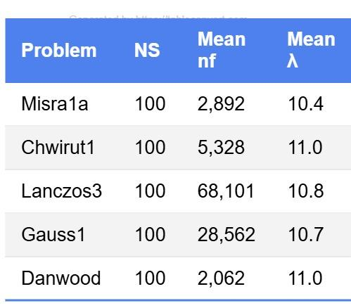
Performance analysis - Lower difficulty models
My results (10 experiments)
Paper results (100 experiments)

Slide 20
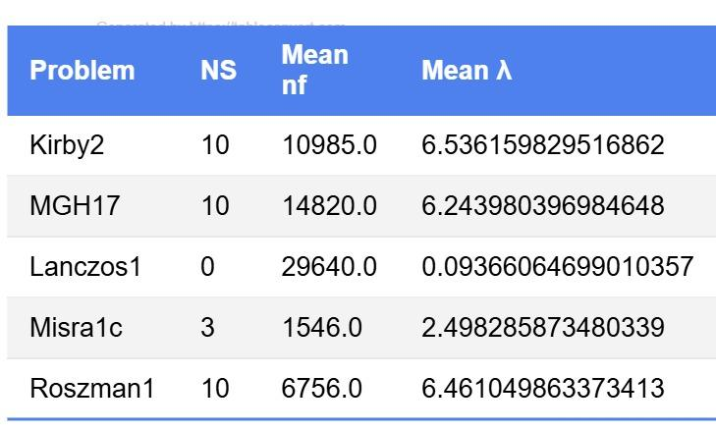
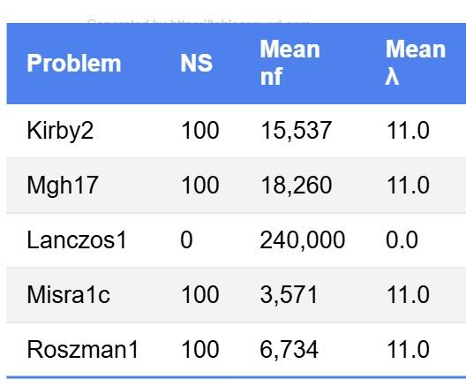
Performance analysis - Average difficulty models
My results (10 experiments)
Paper results (100 experiments)

Slide 21
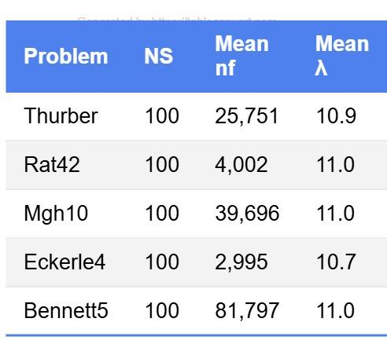
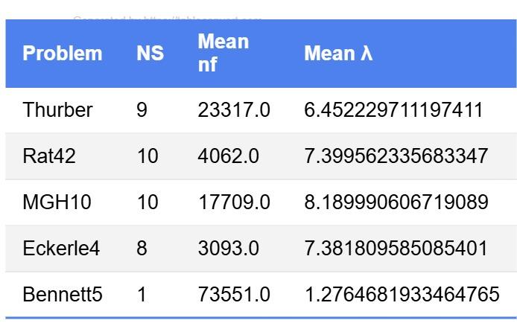
Performance analysis - Higher difficulty models
My results (10 experiments)
Paper results (100 experiments)

Slide 22
Conclusions + Possible adjustments
The algorithm generally performs well, yielding maximum successful runs for 6 out of 15 experiments.
The algorithm handles complex data very well, perhaps even better than simple data. This indicates that it is more suitable for complex regression problems.
Possible adjustments for improving performance include:
modifying the rate of adaptation for balancing exploration and exploitation;
adjusting the bounds for the initial values of vectors.

Slide 23
References
R. Storn and K. Price, Differential Evolution–A simple and efficient heuristic for global optimization over continuous spaces, Journal of Global Optimization, vol. 11, no. 4, pp. 341-359, 1997, doi: 10.1023/A:1008202821328.
Wongsa, Watchara & Puphasuk, Pikul & Wetweerapong, Jeerayut. (2024). Differential evolution with adaptive mutation and crossover strategies for nonlinear regression problems. Bulletin of Electrical Engineering and Informatics. 13. 3503-3514. 10.11591/eei.v13i5.6417.
- National Institute of Standards and Technology (NIST). (n.d.). Nonlinear Least Squares Regression. Retrieved May 10, 2025, from https://www.itl.nist.gov/div898/handbook/pmd/section1/pmd142.htm
- National Institute of Standards and Technology (NIST). (n.d.). Nonlinear Least Squares Regression Background Information. Retrieved May 10, 2025, from https://www.itl.nist.gov/div898/strd/nls/nls_info.shtml
- National Institute of Standards and Technology (NIST). (n.d.). Statistical Reference Datasets (STRD). Retrieved May 10, 2025, from https://www.itl.nist.gov/div898/strd/frames.html

Slide 24
Thank you!
Do you have any questions?

